Slide 1

ع ورت ک ا م

Slide 2

Women Labour Platform
Our solution aims to create an intangible arena for supply and demand of women labour interact to promote women empowerment through connecting women sellers and buyers over a single platform; thus making them active agents of economic and social change in Pakistan.

Slide 3
Problem #1: Gender gap in labor force
Our solution aims to create an intangible arena for supply and demand of women labour interact to promote women empowerment through connecting women sellers and buyers over a single platform; thus making them active agents of economic and social change in Pakistan.

Slide 4
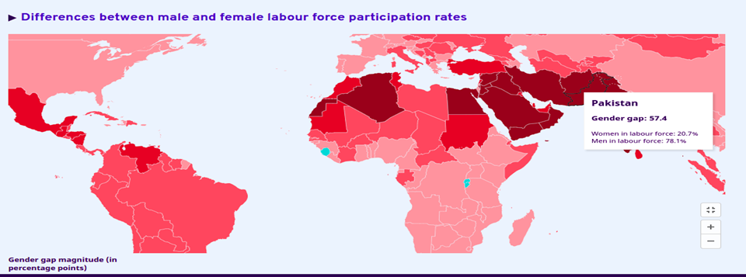
Source : ILOSTAT, ILO modelled estimates, November 2021

Slide 5

Where should I look for better earning opportunities ?
Remote workplace to sell services?
How shall I make use of my skillset?
Safe environment to work?

Slide 6

Problem #2: Insecure working environment for skilled women.
“I have god gifted art, I can do something embroidery, I have art, but I am facing problems in finances.” (Responded ER)
"We have ideas, but we lack in finances and family support." (Responded EX)

Slide 7




One stop solution for financial stability, opportunity building platform and secure marketplace for women
Sell your services and earn.
Work for what you love the most.
Get employed.
Connect with women and build a network.

Slide 8

Key Goals
Promote women’s economic rights and independence, including access to employment, appropriate working conditions and control over economic resources.
Facilitate women’s equal access to resources, employment, markets and trade.
Strengthen women’s economic capacity and commercial networks.
Eliminate occupational segregation and all forms of employment discrimination.
Create a competent marketplace for women.

Slide 9
Problem Solutions
Opportunity building platform for all the women.
Providing a platform where all the women can come and find opportunities of their respective fields.
Support the community of women currently working in technology and to help pave the way for women and young women who want to enter the industry.

Slide 10


Slide 11


Slide 12
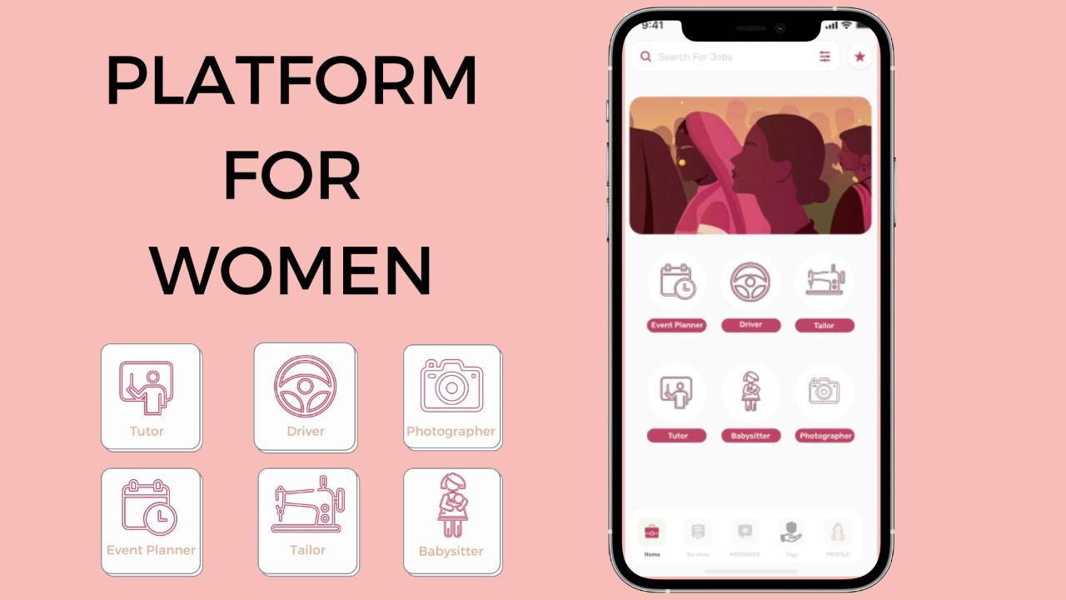

Slide 13
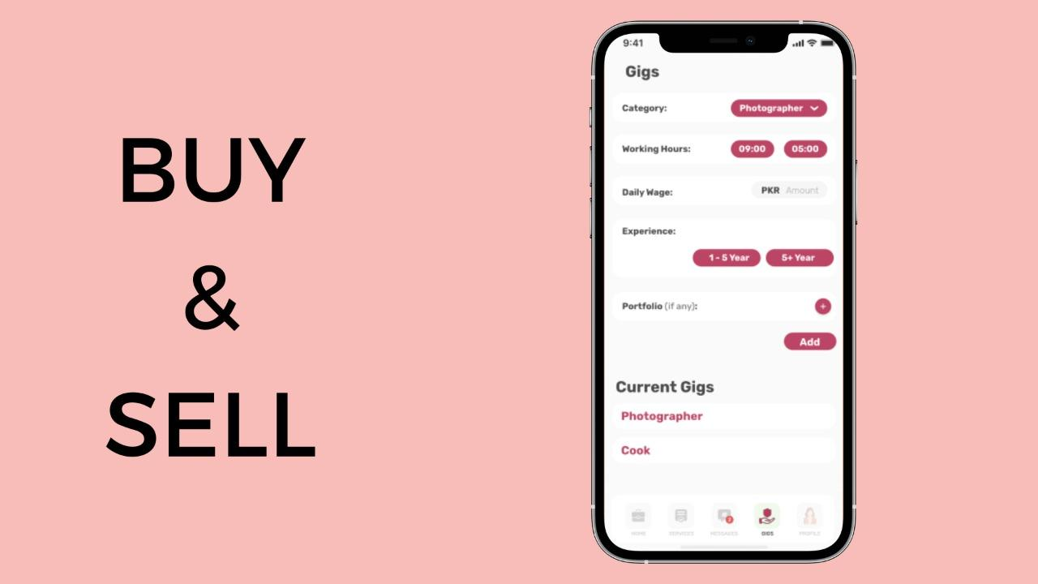

Slide 14
Business Model
FindHer’s business model and growth driver is its track record of successfully enabling women to connect at a large scale and promote their services.
The revenue model of FindHer is based on charging a fee for every successful service performed through the platform.
The Service Provider is charged a variable fee based on the billing of service whether its an hourly or a fixed price service.
The Service consumer is charged a fixed percentage of the service that she has consumed.

Slide 15



Technologies

Slide 16
FAQ’s
If a long term relation is maintained between between client and customer , how will you earn?
Maintain badges and give good rating to customers so as to increase credibility and higher the rating , the lower the commission.
2. What if a customer complains that the service provider(A women) had stolen my assets?
The platform will have a partnership with insurance company.Each women(consumer) on placing the service order will commit to “Book with Insurance” policy and the company will be responsible for reimbursement and also A negative rating will be assigned to the women service provider. On 3 consecutive warnings , legal action will be taken.

Slide 17




Team
FindHer
Subhan Saleem
Ahsan Akhtar
Ahmed Raza
Mustafa Bawany

